Slide 1
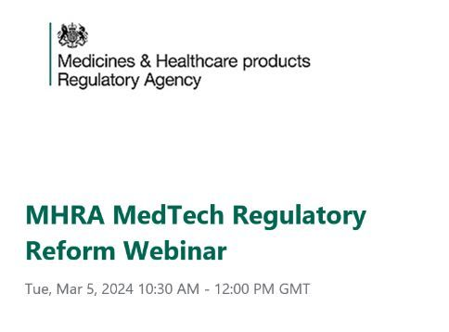
MHRA MedTech Regulatory Reform Webinar
Take-Home Messages

Slide 2
MHRA’s MedTech Regulatory Reform Webinar – March 5
📌 There will be three statutory instruments on #postmarketsurveillance, future Core Regulations, future Enhanced Regulations
📌 MHRA will be aligning with key global regulatory bodies and will pursue/enable international mutual recognitions for medical devices in alignment with their approach for medicines. Within this context, SaMD and companion diagnostics are now in scope and will be prioritized
📌 The concept of intended purpose is redefined to be paired with the requirements of the new Legislation for claims

Slide 3
MHRA’s MedTech Regulatory Reform Webinar – March 5
📌 Alignment with MDR and IVDR
👉 MHRA will do their best to align with MDR/IVDR requirements (apart from references to national bodies and legislations)
👉 This includes an update to the definition of medical devices to ensure consistency
👉 The Essential Requirements will be aligned with the GSPRs
👉MDR’s Annex XVI devices (devices with aesthetic or non-medical purposes) will be covered by the Enhanced Statutory Instruments and not the Core Regulations
There may be some differences in scope for devices such as dermal fillers and coloured contact lenses.

Slide 4
MHRA’s MedTech Regulatory Reform Webinar – March 5
📌 Alignment with MDR and IVDR on Classification
👉 MHRA will deploy a risk-based approach with 23 rules for general medical devices and 7 key rules for the classification of IVDs
👉Software classification will align with IMDRF guidance and there will be a standalone software classification rule
👉There will be some additional rules for substances, nanomaterials, active therapeutic devices, software and IVF/assisted reproduction
👉 IVDs : neurodegenerative diseases and cardiovascular disease will be class C and IVDs for monitoring of life-threatening infectious diseases, such as Ebola will be class D. Companion diagnostics, direct to consumer tests, software and AI, genetic testing, in-house manufactured tests and wearables are all be classified

Slide 5
MHRA’s MedTech Regulatory Reform Webinar – March 5
📌 User Information will be prioritized and enhanced: There will be new requirements for labelling and information provision requirements especially for Software as a Medical Device but other groups of medical devices as well. Additional requirements will most likely be applicable for artificial intelligence related to the performance and operation to ensure that uncertainties about long-term use of these devices are addressed.
* Software is defined as “a set of instructions that processes input data and creates output data”.

Slide 6
MHRA’s MedTech Regulatory Reform Webinar – March 5
📌 MHRA will prioritize environmental sustainability, allowing manufacturers to opt for electronic instructions for use eIFU.
Within the same context, focus will be on usability requirements to ensure end-users can safely and correctly use medical devices.

Slide 7
How can Evnia help?
Headquartered in Denmark, the company current has offices in the UK, Greece, Switzerland and Italy and is servicing life-science clients globally.
It has been certified under ISO 9001:2015 as a Clinical and regulatory affairs consulting agency within the life science industry.
Evnia offers a cluster of interconnected services from the early stages of a medical device’s lifecycle until its post-market adulthood.
We support healthcare innovation and promotion of patient safety by providing services in the fields of:
📌 Due Diligence
📌 Regulatory Strategy
📌Clinical Development Strategy
📌 Post-Market Surveillance
📌 Real World Evidence
📌 Market Access and Reimbursement
📌 EU and UK Representation Services (Authorised Representative & UKCA UKRP)

Slide 8
Regulatory Affairs
Clinical Affairs
Real World Evidence
Representation Services
Patient Treatment
Real World Evidence

