Slide 1
Optimize your vigilance searches with Evnia’s EVA algorithm

Slide 4
How can Evnia help?
Headquartered in Denmark, the company current has offices in the UK, Greece, Switzerland and Italy and is servicing life-science clients globally.
It has been certified under ISO 9001:2015 as a Clinical and regulatory affairs consulting agency within the life science industry.
Evnia offers a cluster of interconnected services from the early stages of a medical device’s lifecycle until its post-market adulthood.
We support healthcare innovation and promotion of patient safety by providing services in the fields of:
📌 Due Diligence
📌 Regulatory Strategy
📌Clinical Development Strategy
📌 Post-Market Surveillance
📌 Real World Evidence
📌 Market Access and Reimbursement
📌 EU and UK Representation Services (Authorised Representative & UKCA UKRP)

Slide 5
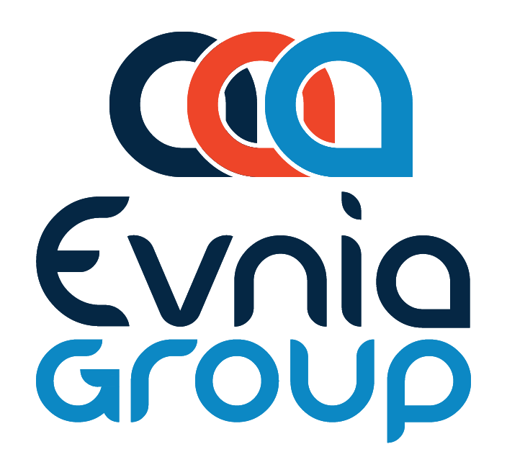
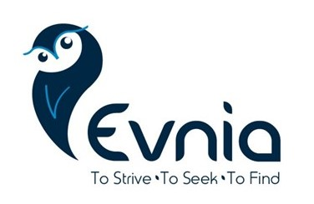
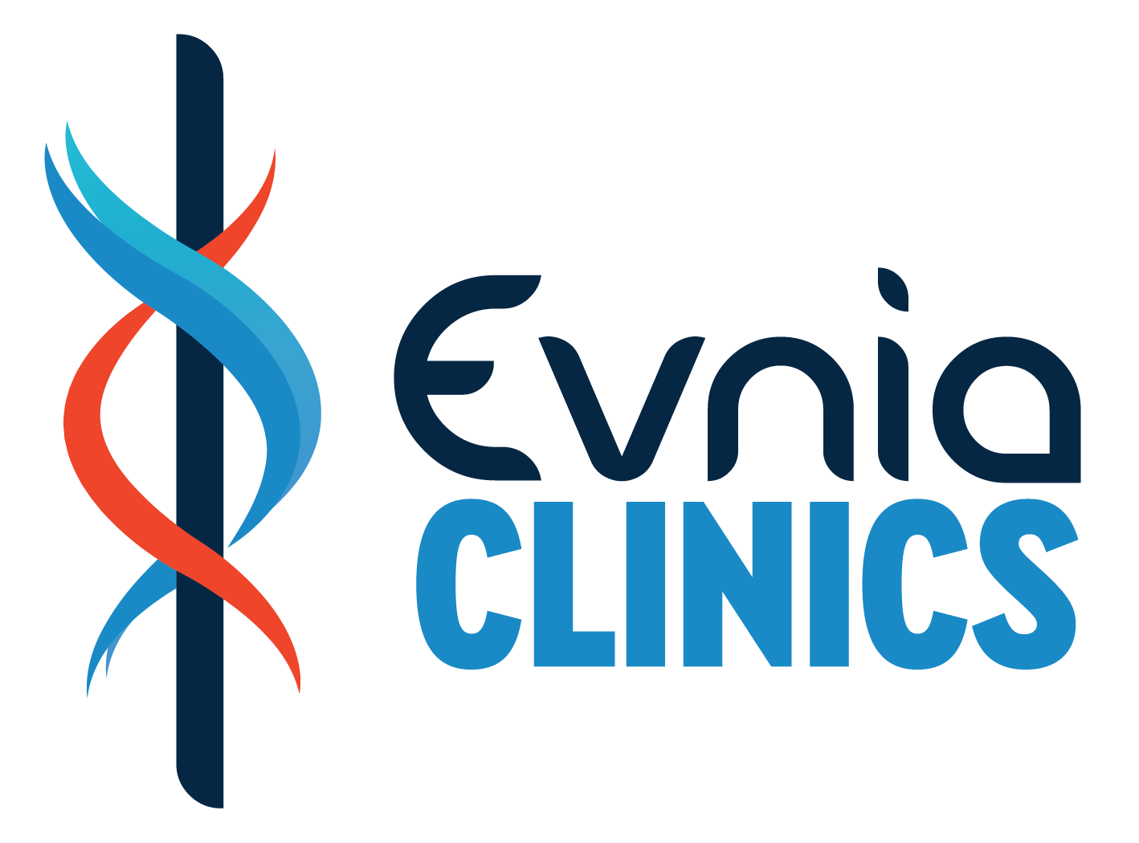
Regulatory Affairs
Clinical Affairs
Real World Evidence
Representation Services
Patient Treatment
Real World Evidence

