Slide 1
US FDA’s eSTAR
Electronic Submission Template,
Version 5

Slide 2
The basics
“Electronic Submission Template and Resource” (eSTAR) is an interactive PDF form that guides applicants through the process of preparing a comprehensive medical device submission.
eSTAR is free and required for all medical device 510(k) submissions, unless exempted. Although currently free to use, the standard submission fees for 510(k) and De Novo still apply!
eSTAR is the ONLY way to submit 510k(s) after October 1, 2023 (unless exempted)
A Refuse to Accept (RTA) review is not conducted on submitted eSTAR templates as the eSTAR template replaces this checklist and states if the template is complete or incomplete on the first page. If the eSTAR does not have a completed status, it will not be reviewed by the FDA.

Slide 3
Update: December 6, 2023 – Version 5.0
eSTAR is now available for voluntary use for the following Premarket Approval Applications (PMAs) submission types:
Original PMAs
PMA Panel Track Supplements (PTS)
PMA Real-Time (RT) Supplements
PMA 180-Day Supplements
All 510(k) submissions, unless exempted, must be submitted as electronic submissions using eSTAR, as noted in the final guidance: Electronic Submission Template for Medical Device 510(k) Submissions.
All 510(k) submissions, unless exempted, must be submitted as electronic submissions using eSTAR, as noted in the final guidance: Electronic Submission Template for Medical Device 510(k) Submissions. Link here
https://www.fda.gov/media/152429/download

Slide 4
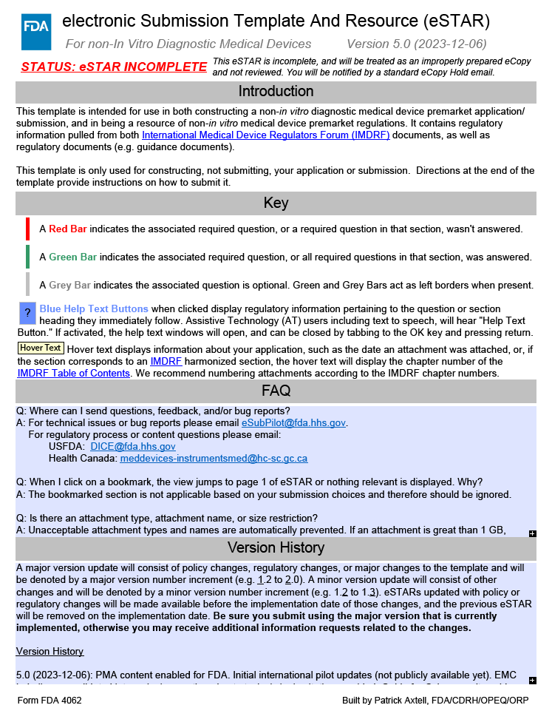
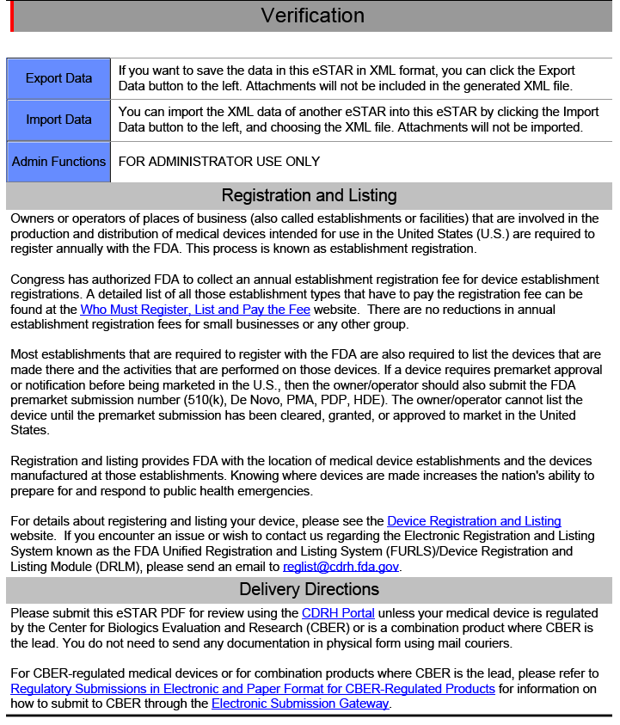
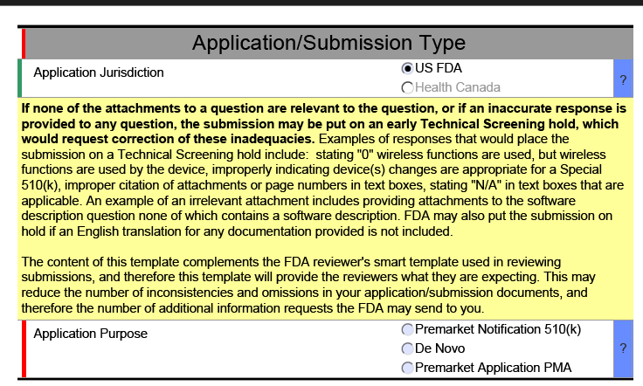

Slide 5
Update: December 6, 2023 – Version 5.0
The new update includes eSTAR templates for In Vitro Diagnostics (IVDs) and non-In Vitro Diagnostic (n-IVDs) medical devices
February 4th is the deadline to switch from version 4 to version 5
The new update facilitates the submission of several PMA submission types but not Modular PMAs yet.
For now, the use of eSTAR for PMA submissions remains voluntary. However, it is expected that an 1-year implementation window will be deployed after the publication of the final guidance for PMA submissions.

Slide 6
Update: December 6, 2023 – Version 5.0
Most important updates are related to cybersecurity, electromagnetic compatibility and sterility.
Details are available in the version history section of the templates.
Major revisions
      PMA content has been enabled
      New popup message added if Adobe Acrobat Reader is used – Always use the PRO version
      EMC Labeling requirements have been consolidated into a single question
      A Cybersecurity Guide has been added with instructions how to add content (see next slide)
      Pyrogenicity testing limit options and help text have been added
      One question about EtO residuals has been updated in the Sterility section
      ISO 18562 information has been added to the Biocompatibility section
      Cross-section change reminders have been added to help texts in the Device Description section
      Clinical Testing section now displays when using PDF-XChange Editor

Slide 7
Update: December 6, 2023 – Version 5.0
Cybersecurity updates
    Threat Model (addressing end-to-end elements)
    Cybersecurity Risk assessment (methodology + acceptance)
    Software Bill of materials
    End of support dates (all SOUP / OTS with a requirement to be provided if not available)
    Assessment of unresolved anomalies
    Metrics
    Controls
    Architecture views
    Testing
    Labeling
    Requirement for a Management Plan

Slide 8
How can Evnia help?
Our team of in-house experts with long experience in FDA regulatory affairs, will help you prepare for the new changes and will guide you through application process.
Tailored solutions, pragmatic approach.

