Slide 1
Key Highlights

Slide 2
MDCG 2021-6, Rev. 1
Published on Dec 12th, this document provides updates on the previous document published in April of 2021. There are
11 updated answers, reflecting the latest developments in EU regulations concerning clinical investigations for medical devices
19 new questions and answers covering topics such as the conduct of combining 2 different study designs in the same CIP, the conduct of clinical investigations for combinations of medical devices and medicinal products, required submission documents, considerations for usability testing, the role and responsibilities of a sponsor's legal representative etc.
a new Annex to help determine whether a combination product falls under the scope of MDR clinical investigation requirements

Slide 3
Key highlights
Applicable regulations (Q2, Q4, Q5)
Study types (e.g., usability testing) (Q17, Q18)
Studies combining devices with medicinal products (Q14, Q15, Q16, Annex III)
Application documents for study types (Q25, Q26, Q27,Q28)
Assessment of substantial modifications (Q32)
Early termination notification (Q39)
Document retention (Q41)
Summary clinical investigation report template (Q43)
EUDAMED clinical module (Q44)
Sponsor legal representative (Q48, Q49, Q50)

Slide 4
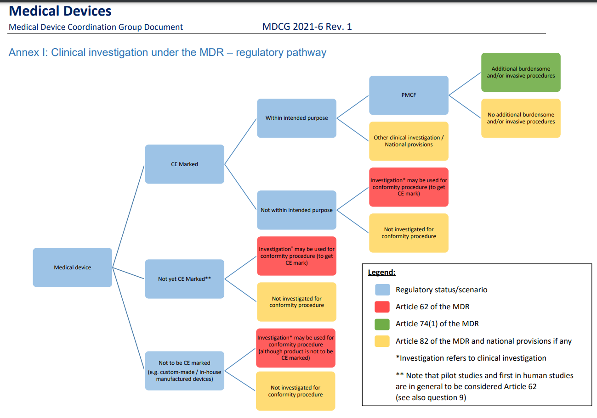
Clinical Investigation under the MDR – Annex I

Slide 5
Combination of development stages – Q10
Is it possible to combine several clinical development stages (e.g. pilot/pivotal) in the same clinical investigation?
In some situations, a sponsor may consider it appropriate to include two different study designs in the same CIP (exploratory and confirmatory) to investigate a device for the same intended use and clinical indication as it progresses through clinical developmental stages (e.g. pilot and pivotal stage).
This approach should be used restrictively, as the results from the first stage may provide important input to what is the most suitable study design for the subsequent development stage, but there are situations where the approach could be justified.
👉 Applications regarding clinical investigations with a phased approach may be subject to conditional approval, where the condition could be that a substantial modification notification to the CAs (including data on outcomes of the first stage) is required before the second stage is initiated.

Slide 6
CIs of combinational products – Q14-16 & Annex III
Devices incorporating medicinal substances
Devices intended to administer medicinal products
Per Art. 1(9) of the MDR, any device which is intended to administer a medicinal product shall be governed by the MDR.
Clinical studies of such devices that fulfil the definition of clinical investigation in Article 2(45) of the MDR are subject to the MDR requirements for clinical investigations.
However, if the device intended to administer the medicinal product and the medicinal product are combined in such a way that they form a single integral product which is intended exclusively for use in the given combination, and which is not reusable, that single integral product shall be governed by Directive 2001/83/EC21 or Regulation (EC) No 726/200422 as applicable.
In that case, the GSPRs set out in Annex I of the MDR shall apply for the safety and performance of the device part.
Clinical studies of such integral products may be considered clinical trials regulated by the Regulation (EU) 536/2014 on clinical trials for medicinal products for human use (CTR).
A device that, as an integral part, incorporates a substance which, if used separately, would be considered to be a medicinal product and that has an action ancillary to that of the device shall be assessed and authorised in accordance with the MDR.
If the action of the medicinal substance is principal, the integral product shall be governed by Directive 2001/83/EC21 or Regulation (EC) No 726/200422 as applicable.
In that case, the GSPRs set out in Annex I of the MDR shall apply for the safety and performance of the device part.
Clinical studies of such integral products may be considered clinical trials regulated by the Regulation (EU) 536/2014 on clinical trials for medicinal products for human use (CTR).

Slide 7
CIs of combinational products – Q14-16 & Annex III
Which regulatory pathway shall a sponsor follow to conduct a clinical study (investigation) to collect clinical data both for a medicinal product and a device that will be used to administer the medicinal product, but it is not a single integral product?
Is there a common EU procedure for combined studies with devices and medicinal products?
👉 No, clinical investigations of devices are regulated by the MDR, while clinical trials of medicinal products are regulated by the Regulation (EU) 536/2014 on clinical trials for medicinal products for human use (CTR).
There is no dedicated procedure for combined studies foreseen in the regulations and therefore, currently, no harmonized procedure is in place.
Therefore, the clinical study has to be designed so that it fulfils both regulations. In administrative terms, combination studies have to be submitted as a notification or application for a device clinical investigation under the MDR and as a medicinal product clinical trial under the CTR.
👉 The study documentation required for submissions (if applicable) may be partially overlapping.
A clinical study which is collecting data for both a device and a medicinal product will have to comply with the regulatory requirements in relation to clinical investigations of medical devices (in the MDR) as well as the regulatory requirements for clinical trials of medicinal products, which are governed by the Regulation (EU) 536/2014 on clinical trials for medicinal products for human use (CTR).
👉 If data on the device are being collected for conformity assessment purposes, Art. 62 of the MDR applies.

Slide 8
CIs of combinational products –Annex III

Slide 9
Usability testing – Q 17
According to the MDR, are usability tests considered clinical investigations?
Usability is created by characteristics of the user interface that facilitate use, i.e., to make it easier for the user to perceive information presented by the user interface, to understand and to make decisions based on that information, and to interact with the medical device to achieve specified goals in the intended use environments. Many of these factors can influence safety and performance to various extents.
👉 Depending on the overall test design, usability testing may or may not fall under the definition of clinical investigation in Art. 2(45) of the MDR.
👉 Factors to be considered when determining whether a usability test is also a clinical investigation should include the scope and purpose of testing, as well as how the human subjects are exposed to the device. Note that prototypes or parts of a future device may have a medical purpose which is evaluated in the usability test and they would thus be considered as investigational devices, whereby the test could be a clinical investigation, in particular when the usability test involves exposing users to risk related to the device or where poor usability may lead to patient or user safety risks.
Manufacturers should document (as part of the technical documentation) their justification of why a particular usability test falls outside the definition of a clinical investigation if human subjects are involved.
Typically, a usability test that fulfils the definition of clinical investigation falls under Art. 62(1) of the MDR, but there may be situations where Art. 82 of the MDR could be relevant.

Slide 10
Retrospective data – Q18
May a retrospective clinical study fall under the definition of a clinical investigation?
If performance and/or safety of the device are analysed in the study retrospectively, separately from the decision to use the device, the study should not be considered as a clinical investigation according to the MDR, however there may be national provisions and/or GDPR requirements which need to be taken into consideration.
👉 Data from such studies may form part of the clinical evaluation in appropriate circumstances.

Slide 11
Devices used for medical purposes in research involving human subjects – Q19
When the objective of a clinical study is not specifically to evaluate a device, but the device is necessary for the purpose of the study (e.g. study of a physiological process, or a medical method or a surgical technique or rehabilitation technique) what regulatory aspects related to the device must the sponsor take into account?
👉 For devices lacking CE-marking, the only option available may be to design the study as a clinical investigation of the device and seek the necessary approvals.
Although the main research purpose might not be to study the performance and/or safety of the device, these could be made secondary objectives. National legislation may provide further options.
👉 Use of CE-marked devices outside their intended purpose in a clinical research setting should be carefully considered from a risk perspective, and may not always be appropriate, depending on the degree of deviation from the intended purpose stated by the manufacturer.
Any device which is used for medical purposes as per Art. 2(1) in research involving human subjects needs to comply with the requirements of the MDR that are applicable to it.

Slide 12
Substantial Modifications – Q30-35
👉 In order for the data resulting from a clinical investigation to be relevant for a certain device, in a situation where several versions of the device have been used during the clinical investigation, the aspect of equivalence may need to be considered.
👉 MDCG 2020-5 provides guidance on equivalence in relation to clinical evaluation. This guidance may support sponsors in determining whether a modification of a device could be done within the same clinical investigation, or if a new clinical investigation application should be submitted.
👉 Member States will assess on a case-by-case basis if a change to the investigational device alters the suitability of the clinical investigation design to provide evidence for the safety, performance or clinical benefit of the device. If the modified investigational device is not equivalent to that one object of the initial application, according to MDCG 2020-5, a new clinical investigation may be required.
It is the sponsor’s responsibility to determine if the modification is substantial or not.
👉 However, if the sponsor is uncertain about the impact for a particular modification of a clinical investigation, the National Competent Authority may be consulted prior notification.
In general, a change to the investigational device is a substantial modification of the clinical investigation, e.g., a change to the device which alters the risk profile or adds new risks is likely to have a substantial impact on the safety or health or rights of the subject and, thus, is a substantial modification.

Slide 13
Early termination - Q39
When does the sponsor have to notify an early termination of a clinical investigation?
In case a clinical investigation is temporarily halted or terminated early, the sponsor has to inform the Member State concerned within 15 days, or within 24 hours if based on safety grounds.
This reporting timeline should be counted from the sponsor’s decision to halt/terminate the clinical investigation.
In case of restart after temporarily halted study, a notification will be made to the CA.
In case of temporarily halt on safety grounds, this notification should be submitted as a substantial modification.
👉 If inclusion of new subjects is halted in a country before the expected number of subjects in that Member State was reached, and this is due to the achieved recruitment of the total number of subjects globally, this is not considered as early termination.

Slide 14
Retention of documents – Q41
For how long must study documentation be retained?
The documentation mentioned in annex XV shall be kept for a period of at least 10 years after the clinical investigation with the device in question has ended, or, in the event that the device is subsequently placed on the market, at least 10 years after the last device has been placed on the market. In the case of implantable devices, the period shall be at least 15 years.

Slide 15
EUDAMED – Q44-45
The use of EUDAMED for Clinical Investigation and Performance Studies becomes mandatory at the end of the 6 months transitional period after the publication of a notice in the Official Journal of the European Union that EUDAMED has achieved full functionality following the outcome of an independent audit.
👉 It will not be possible to submit applications via EUDAMED before it is mandatory to use.
Until the clinical investigation module in EUDAMED is ready, how can the sponsor comply with the MDR?
All requested information to apply for or notify a clinical investigation should be submitted to the national competent authorities unless otherwise specified in the MS concerned.

Slide 16
Legal representative – Q48-50
👉 The legal representative is responsible for ensuring compliance with the sponsor’s obligations pursuant to the MDR.
👉 If tasks are delegated by a legal representative to another legal or natural person, the
👉 HOW the sponsor will achieve the above should be specified in the contractual agreement between the sponsor and the legal representative.
👉 A sponsor of a clinical investigation that is not established in the Union, shall ensure that a natural or legal person is established in the EU as its legal representative.
The legal representative should have permanent and unlimited access to
the complete and up-to-date investigation master file including, but not limited to, contracts and financial arrangements related to the clinical investigation
evidence that the investigational sites and other participating entities and persons are appropriately qualified
relevant communication which can support the demonstration of compliance of sponsor’s duties according to the MDR
monitoring reports and SAE reports.

